Slide 1

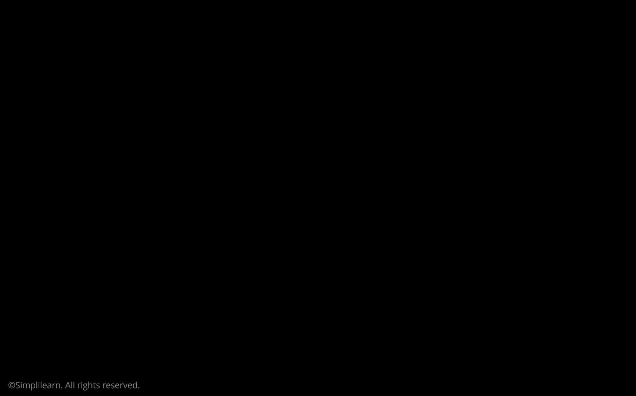





Deep Learning with Keras with TensorFlow

Slide 2
Recurrent Neural Networks (RNN)

Slide 3

By the end of this lesson, you will be able to:
Implement RNNs for sequential data
Use LSTMs for memory operations within RNNs
Perform gated operations in LSTMs using GRUs
Improve the performance of LSTMs using the Attention mechanism

Slide 4
Sequence Data

Slide 5
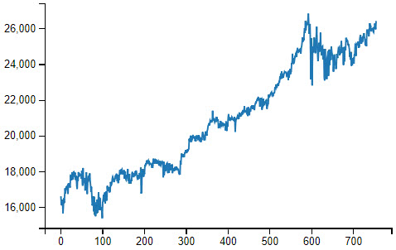
What Is Sequential Data?
The dataset is said to be sequential when the data points are dependent on other data points within a dataset.
Example: Time Series Data

Slide 6

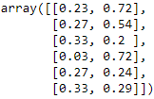



Sequential Data: Problems
Consider you have a sequential data that contains temperature and humidity values for everyday.
Temperature
Humidity
Goal: To build a neural network that imports the temperature and humidity values of a given day and predicts if the weather for that day is sunny or rainy.

Slide 7
Sequential Data: Problems
The data then flows to the hidden layers, where the weights and biases are applied.
Weights ([0.23 + 0.72]) + Bias
Cloudy
Y
Sunny

Slide 8
Sequential Data: Problems
A traditional neural network assumes that the data is non-sequential and each data point is independent of the others.
Cloudy
Y
Sunny
Note: The network does not remember what it gives as an output. It just accepts the next data point.

Slide 9
Sequential Data: Problems
In the weather data, there is a strong correlation between the weather from one day and the weather in subsequent days. The former has influence over the latter.
If it was sunny on one day in the middle of summer, it’s easy to
to presume that it’ll also be sunny on the following day.

Slide 10
Sequential Data: Solution
An RNN has a mechanism that can handle a sequential dataset.
RNN
Data in
Data out
Recurs new state to itself

Slide 11
RNN Model

Slide 12
The RNN Model
The RNN remembers the analysis done upto a given point by maintaining a state.
RNN
Data in
Data out
Recurs new state to itself
Note: You can think of the state as the memory of RNN which recurs into the net with each new input.

Slide 13
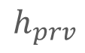
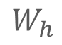
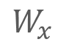
RNN: Working
The first data point flows into the network as input data, denoted as x.
RNN
$$W_{x}$$
x
Y
$$W_{h}$$
$$h_{prv}$$
Weights are multiplied by the previously hidden state
Recurs new state to itself
Previous state received by the hidden units
Weight matrix between input and hidden units

Slide 14
RNN: Working
Two values are calculated in the hidden layer as shown below:
The new or updated state, denoted as h_new, is used for the next data point
The output of the network is denoted as y

Slide 15
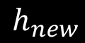
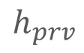
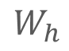
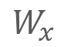
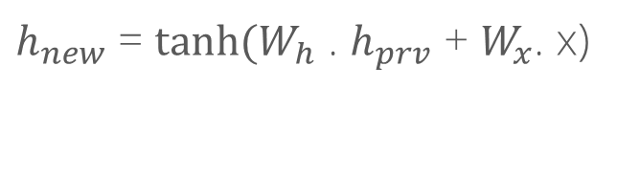
RNN: Working
$$W_{x}$$
x
Y
$$W_{h}$$
$$h_{new}$$
$$h_{prv}$$
$h_{new}$ = $\tanh{(W_{h} }$. $h_{prv}$ + $W_{x}$. x)
Previous state received by the hidden units
The new state is a function of the previous
state and the input data

Slide 16
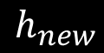

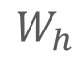
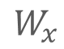
RNN: Working
The output of the hidden unit is simply calculated by multiplication of the new hidden state and the output weight matrix.
$$W_{x}$$
x
Y
$$W_{h}$$
$$h_{new}$$
$$h_{prv}$$
After processing the first data point, a new context is generated that represents the most recent point.
Then, this context is fed back into the net with the next data point and we repeat these steps until all the data is processed.

Slide 17
A Typical RNN
₀
o_{t-1}
o_{t}
O_{t+1}
V
V
s_{t-1}
V
V
W
s_{t}
S_{t+1}
W
Unfold
W
W
W
U
U
U
U
_{x}
X_{t-1}
x_{t}
X_{t+1}
h_{t}
h₀
h₁
h₂
h_{t}
A
A
A
A
A
x_{t}
x₀
x₁
x₂
x_{t}

Slide 18
Reduces Complexity
Given function f: h’, y = f (h,x): h and h’ are vectors with the same dimension.
y¹
y²
y³
h⁰
f
h¹
f
h²
f
h³
……
x¹
x²
x³
We only need one function f, irrespective of the input and output sequences.

Slide 19
Applications of RNN

Slide 20

Speech Recognition
The goal is to consume a sequence of data and then produce another sequence.
RNN
Data in
Data out
Recurs new state to itself

Slide 21
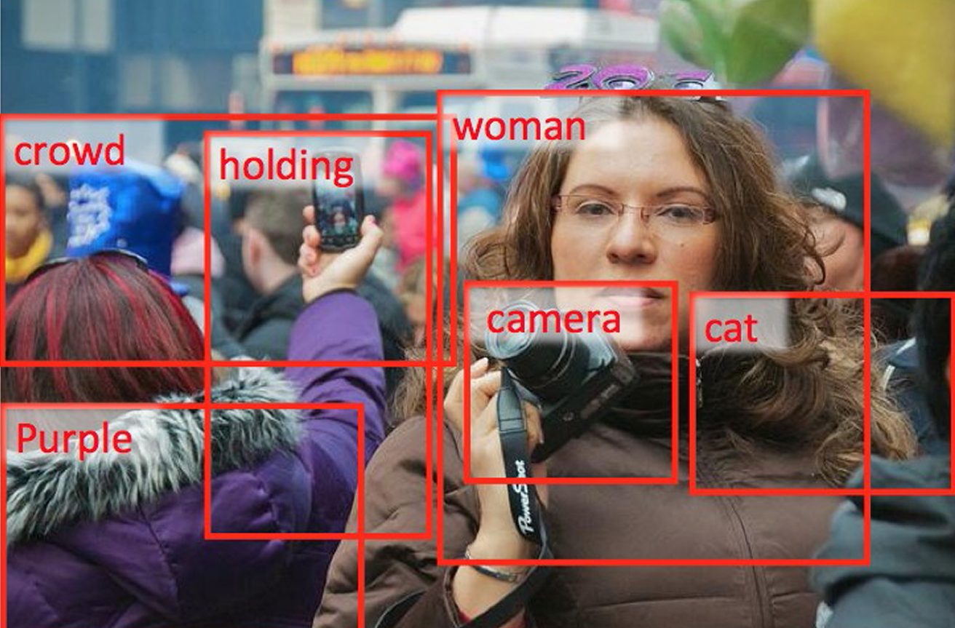
Image Captioning
You can create a model that’s capable of understanding the elements in an image.
RNN
Data in
Data out
Recurs new state to itself
Note: There is just one input (the image) and the output is a sequence of words. Therefore, it is also known as one-to-many.

Slide 22



Sentiment Analysis
RNNs can be used for sentiment analysis, where it focuses only on the final output and not on the sentiment behind each word.
RNN
Data in
Data out
Recurs new state to itself
Note: The RNN here consumes a sequence of data and produces just one output. Therefore, it is also known as many-to-one.

Slide 23
Deep RNNs

Slide 24
Problems with Smaller RNN Networks
If $x_{1}$ .... $x_{n}$ is very large and continues to grow, the fully connected network will become too big.
x1
y1
x2
y2
x3
y3
x4

Slide 25
Bidirectional RNNs
Bidirectional RNNs are constructed by putting two RNNs (f1 and f2) together. Mathematically, these are defined as y,h=f1(x,h) and z,g = f2(g,x).
x²
x³
g⁰
f₂
g¹
f₂
g²
f₂
g³
z¹
z²
z³
p¹
p²
p³
p=f₃(y,z)
f₃
f₃
f₃
y¹
y²
y³
h⁰
f₁
h¹
f₁
h²
f₁
h³
x¹
x²
x³

Slide 26
Deep RNNs
Deep RNNs are constructed by adding more layers to simple RNNs. Mathematically, it can be defined as h’,y = f1(h,x), g’,z = f2(g,y)
…
…
…
z¹
z²
z³
g⁰
f₂
g¹
f₂
g²
f₂
g³
……
y¹
y²
y³
h⁰
f₁
h¹
f₁
h²
f₁
h³
……
x¹
x²
x³

Slide 27
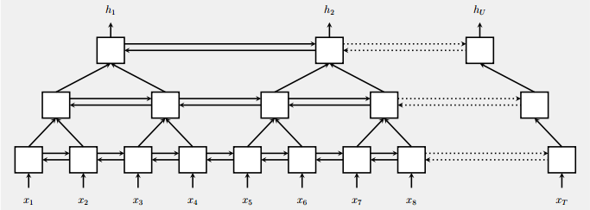
Pyramid RNNs
Pyramid RNNs speed up the training process by reducing the number of timesteps.
Bidirectional RNN

Slide 28
Problems with Deep RNNs
Deep RNNs are very hard to train and usually don’t remember data beyond certain timesteps.
…
…
…
z¹
z²
z³
g⁰
f₂
g¹
f₂
g²
f₂
g³
……
y¹
y²
y³
h⁰
f₁
h¹
f₁
h²
f₁
h³
……
…
…
…
z¹
z²
z³
x¹
x²
x³
g⁰
f₂
g¹
f₂
g²
f₂
g³
……
y¹
y²
y³
h⁰
f₁
h¹
f₁
h²
f₁
h³
……
x¹
x²
x³

Slide 29
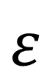
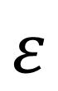
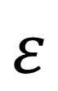
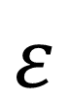
The Problem of Vanishing Gradient with RNNs
The problem arises while updating weights in RNNs. These weights connect the hidden layers to themselves in the unrolled temporal loop.
$$ε$$
$$ε$$
$$ε$$
$$ε$$
t-3
t-2
t
T+1
W_{out}
W_{out}
W_{out}
W_{out}
W_{out}
W_{rec}
W_{rec}
W_{rec}
W_{rec}
W_{in}
W_{in}
W_{in}
W_{in}
W_{in}
Note: When any figure is multiplied by a small number, its value decreases very quickly.

Slide 30
Long Short-Term Memory (LSTM)

Slide 31
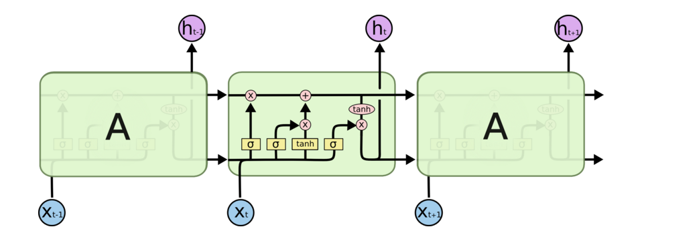
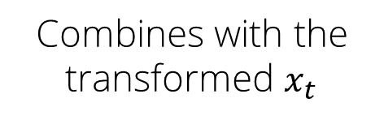
LSTM Architecture
Decides what to forget
Decides what to insert
Bits of memory
Combines with the transformed $x_{t}$

Slide 32
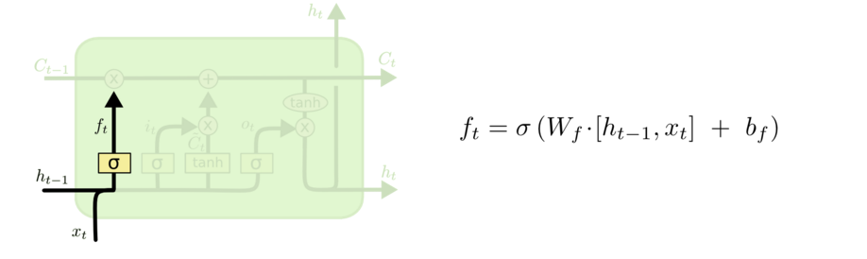
LSTM Architecture
Decides which part of memory to forget. The part to be forgotten is denoted with 0

Slide 33
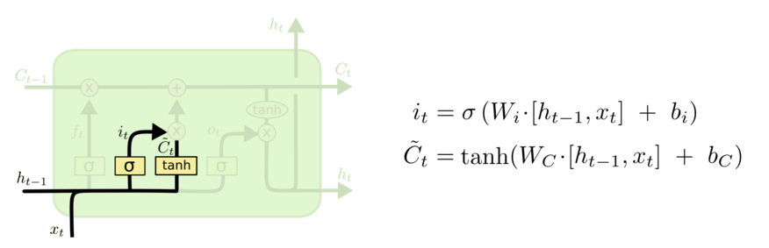
LSTM Architecture
Decides what bits to insert in the next states
Decides what content to store in the next states

Slide 34
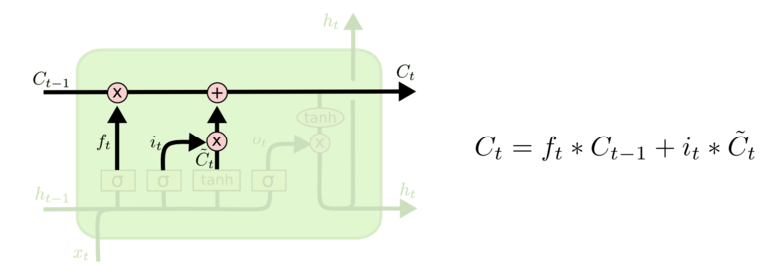
LSTM Architecture
Decides the content of the next memory cell, which is a mixture of the not forgotten part from previous cell and insertion

Slide 35
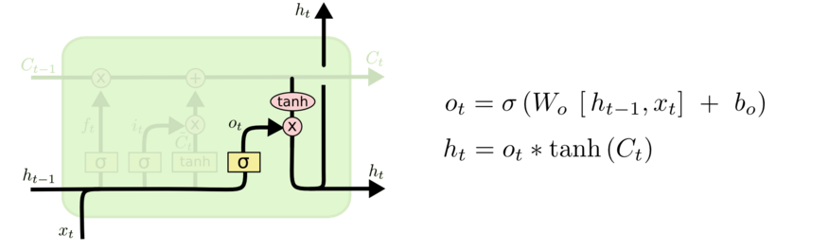
LSTM Architecture
Decides on what part of cell to output
Maps bits within -1 and +1 range

Slide 36
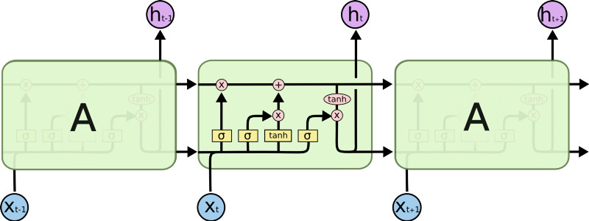
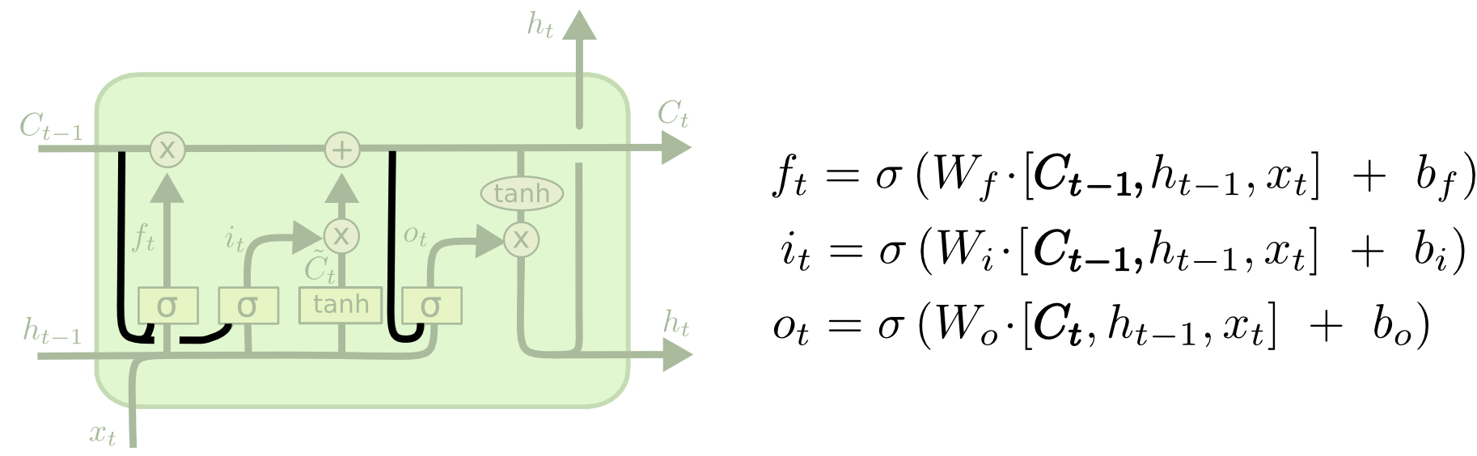
A Peephole LSTM
A peephole LSTM allows peeping into the memory.

Slide 37
Information Flow in LSTM

Slide 38

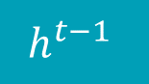
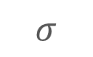





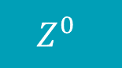
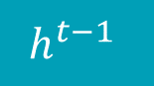



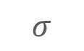
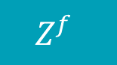


Information Flow in LSTM
$$x^{t}$$
Controls Forget Gate
$$Z^{f}$$
$$σ$$
$$W^{f}$$
$$h^{t−1}$$
$$x^{t}$$
Controls Input Gate
$$Z^{i}$$
$$σ$$
$$W^{i}$$
$$h^{t−1}$$
$$x^{t}$$
Updates Information
Z
W
tanh
$$h^{t−1}$$
$$x^{t}$$
Controls Output Gate
$$Z^{0}$$
$$σ$$
$$W^{0}$$
$$h^{t−1}$$
Note: Above four matrix computations are done concurrently.

Slide 39

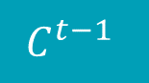







Information Flow in LSTM
$$C^{t−1}$$
$$C^{t}$$
$$Z^{f}$$
.
+
.
$$y^{t}$$
$$h^{t−1}$$
$$Z^{i}$$
c^{t} = z^{f}  c^{t-1} + z^{i}z
h^{t} = zº  tanh(c^{t})
$$x^{t}$$
.
y^{t} = σ(W’ h^{t})
Z
$$Z^{0}$$
$$h^{t}$$
Note:  signifies element-wise multiplication.

Slide 40


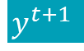
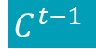
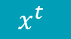
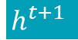
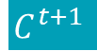
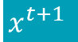
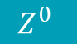
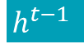

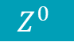





Information Flow in LSTM
The memory from one state is fed to another state along with the new input.
$$C^{t+1}$$
$$Z^{f}$$
.
+
.
$$y^{t+1}$$
$$h^{t}$$
$$Z^{i}$$
$$C^{t−1}$$
$$C^{t}$$
$$x^{t+1}$$
.
.
Z
$$Z^{f}$$
+
.
$$y^{t}$$
$$Z^{i}$$
$$Z^{0}$$
$$h^{t+1}$$
$$h^{t−1}$$
$$x^{t}$$
.
Z
$$Z^{0}$$
$$h^{t}$$

Slide 41
Stock Price Prediction Using LSTM
Problem Statement: Forecasting stock prices has been a difficult task for many of the researchers and analysts. There are a lot of complicated financial indicators, as a result of which the fluctuation of the stock market is highly volatile. The prediction of the market value is of great importance to help in maximizing the profit of stock option purchase while keeping the risk low.
Objective: Use LSTM approach to predict stock market indices on the dataset prices.csv.
Note: Prices dataset are fetched from Yahoo Finance, fundamentals are from Nasdaq Financials, extended by some fields from EDGAR SEC databases.
Access: Click on the Labs tab on the left side panel of the LMS. Copy or note the username and password that are generated. Click on the Launch Lab button. On the page that appears, enter the username and password in the respective fields, and click Login.

Slide 42
Multiclass Classification Using LSTM
Problem Statement: You are given a news aggregator dataset which contains news headlines, URLs, and categories for 422.937 news stories collected by a web aggregator. These news articles have to be categorized into business, science and technology, entertainment, and health.
Objective: Perform multiclass classification using LSTM.
Note: Use uci-news-aggregator.csv for the above task.
Access: Click on the Labs tab on the left side panel of the LMS. Copy or note the username and password that are generated. Click on the Launch Lab button. On the page that appears, enter the username and password in the respective fields, and click Login.

Slide 43
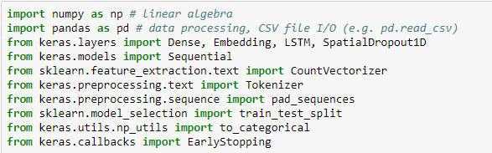
Load Libraries
Import the necessary libraries.

Slide 44
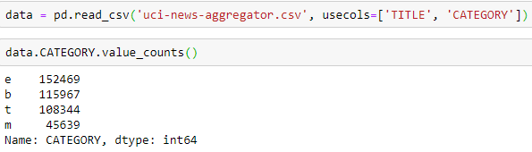
Load Data
Load the .csv file and check the data count in each class.
Note: m-class has way less data than the others, thus the classes are unbalanced.

Slide 45
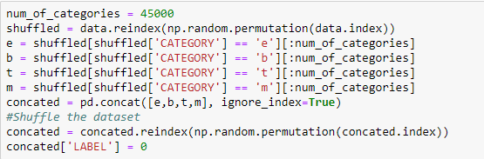
Balance the Data
Perform shuffling to balance the classes.

Slide 46
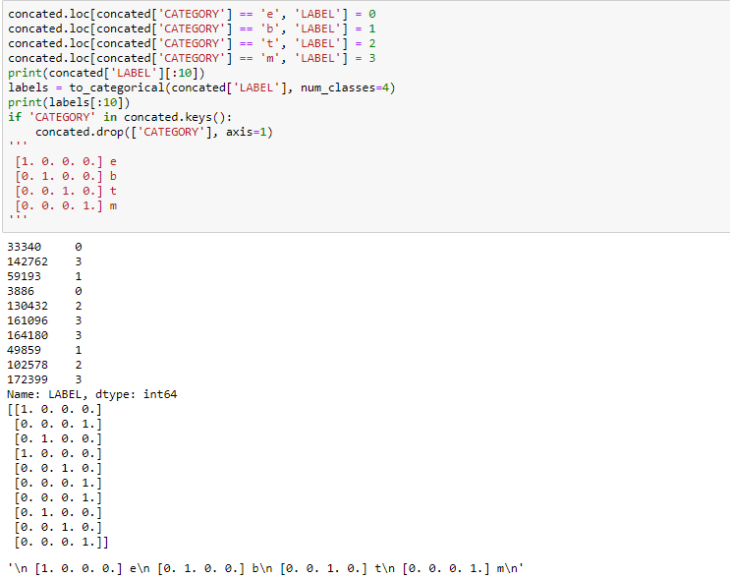
Encode the Data
Perform one-hot encoding on the labels data.

Slide 47
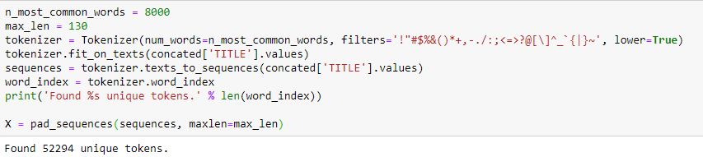
Tokenization
Perform tokenization and identify the number of unique tokens.

Slide 48
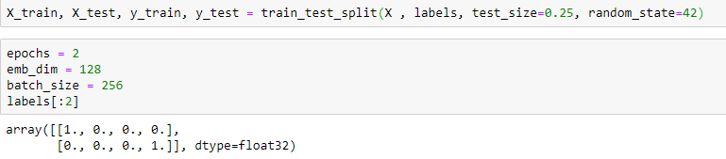
Create Train and Test Sets
Split the dataset into training and testing sets. Also, define epochs, batch size, and labels for the same.

Slide 49

Define the LSTM Model
Code the LSTM model and fit the same into the processed data.

Slide 50

Check Performance
Evaluate the results on training and testing sets and obtain accuracy of the model.

Slide 51

Plot Metrics
Plot the model’s training accuracy versus validation accuracy and training loss versus validation loss.

Slide 52


Plot Metrics

Slide 53

Perform Predictions
Perform label predictions against random data.

Slide 54
Sentiment Analysis Using LSTM
Problem Statement: Sentiment Analysis is one of the common problems that companies are working on. The most important application of sentiment analysis comes while working on natural language processing tasks. The motive of your company behind building a sentiment analyzer is to determine employee concerns and to develop programs to help improve the likelihood of employees remaining in their jobs.
Objective: Use LSTM to perform sentiment analysis in Keras.
Note: Use the inbuilt dataset imdb from keras.datasets for this task.
Access: Click on the Labs tab on the left side panel of the LMS. Copy or note the username and password that are generated. Click on the Launch Lab button. On the page that appears, enter the username and password in the respective fields, and click Login.

Slide 55
Gated Recurrent Unit (GRU)

Slide 56

GRU Architecture
Performs label predictions against random data.
Update Gate
Reset Gate

Slide 57

GRU Architecture
Update Gate
Determines how much of the past information (from the previous time steps) needs to be passed along to the future.
Reset Gate
Current Memory
Current State

Slide 58

GRU Architecture
Update Gate
Determines how much of the past information needs to be forgotten.
Reset Gate
Current Memory
Current State

Slide 59

GRU Architecture
Update Gate
The current memory is computed using the reset gate to store relevant information from the past.
Reset Gate
Current Memory
Current State
Note: Here tanh is the nonlinear activation function.

Slide 60
GRU Architecture
Update Gate
At the final stage, h_t vector is calculated such that it holds the information for the current unit and passes it down to the network.
Reset Gate
Current Memory
Current State

Slide 61
LSTM vs. GRU
LSTM
Tracks long-term dependencies while mitigating the vanishing or exploding gradient problems. It does so via input, forget, and output gates.
Controls the exposure of memory content
GRU
Tracks long-term dependencies using a reset gate and an update gate
Exposes the entire cell state to other units in the network

Slide 62
The Attention Model

Slide 63



Attention Model
Notes:
Trainer Notes:
Glimpse Sensor: A) Given the coordinates of the glimpse and an input image, the sensor extracts a retina-like representation ρ(xt, lt−1) centered at lt−1 that contains multiple resolution patches. B) Glimpse Network: Given the location (lt−1) and input image (xt), uses the glimpse sensor to extract retina representation ρ(xt, lt−1). The retina representation and glimpse location is then mapped into a hidden space using independent linear layers parameterized by θ 0 g and θ 1 g respectively using rectified units followed by another linear layer θ 2 g to combine the information from both components. The glimpse network fg(.; {θ 0 g , θ1 g , θ2 g}) defines a trainable bandwidth limited sensor for the attention network producing the glimpse representation gt. C) Model Architecture: Overall, the model is an RNN. The core network of the model fh(.; θh) takes the glimpse representation gt as input and combining with the internal representation at previous time step ht−1, produces the new internal state of the model ht. The location network fl(.; θl) and the action network fa(.; θa) use the internal state ht of the model to produce the next location to attend to lt and the action/classification at respectively. This basic RNN iteration is repeated for a variable number of steps

Slide 64
Encoder-Decoder Framework
Encoder: From word sequence to sentence representation
Decoder: From representation to word sequence distribution
Universal Representation: Intermediate representation of meaning
English sentence
English sentence
English
decoder
English
decoder
For bitext data
For unilingual data
French
encoder
English
encoder
French sentence
English sentence

Slide 65

Motivation
Limited representation
Constrained over longer distances

Slide 66


Improving Performance with LSTM
Example:
Reversing the order
Instead of mapping the sentence a, b, c to the sentence α, β, γ, the LSTM is asked to map c, b, a to α, β, γ, where α, β, γ is the translation of a, b, c. This way, a is in close proximity to α, b is fairly close to β, and so on.

Slide 67
Examples of Attention

Slide 68

Example 1
One-to-many
Many-to-one
Many-to-many
Many-to-many
The way an LSTM chooses what to forget and what to insert into memory, determines what inputs the network will attend to in the generation phase

Slide 69

Example 2

Slide 70


Example 3
Translated MNIST inputs
Cluttered Translated MNIST inputs

Slide 71

Example 4
Similar to the way an LSTM chooses what to forget and insert into memory, allow a network to choose a path to focus on in the visual field

Slide 72
The Attention Mechanism

Slide 73
Improving Performance with LSTM
Consider an input (or intermediate) sequence or image
Consider an upper level representation, which can choose where to look, by assigning a weight or probability to each input position, applied at each position
Higher-level
Softmax over lower locations conditioned
on context at lower and higher locations
Lower-level

Slide 74


NMT with Recurrent Nets and Attention Mechanism
Notes:
Trainer Notes:
Intuitively, this implements a mechanism of attention in the decoder. The decoder decides parts of the source sentence to pay attention to. By letting the decoder have an attention mechanism, we relieve the encoder from the burden of having to encode all information in the source sentence into a fixed length vector. With this new approach the information can be spread throughout the sequence of annotations, which can be selectively retrieved by the decoder accordingly.

Slide 75


Image-to-Text: Caption Generation with Attention

Slide 76
Neural Attention Models

Slide 77

Neural Attention Model for Sentence Summarization
The heatmap represents a soft alignment between the input and the generated summary.
Output of the attention-based summarization system.

Slide 78

Neural Attention Model for Sentence Summarization
Attention-based encoder enc3
NNLM (Neural Net Language Models) decoder with additional encoder element

Slide 79




Neural Attention Model for Sentence Summarization
Decoder: NNLM

Slide 80


Neural Attention Model for Sentence Summarization
Encoder: NNLM

Slide 81
Quora Insincere Questions Classification
Problem Statement: An existential problem for any major website today is how to handle toxic and divisive content. Quora wants to tackle this problem head-on to keep their platform a place where users can feel safe sharing their knowledge with the world. As an approach to the solution, you must create models that identify and flag insincere questions (a question intended to make a statement rather than look for helpful answers.)
Objective: Predict whether a question asked on Quora is sincere or not.
Note: Use the word embeddings provided along with the datasets to accomplish your goal. Also, use tf1.14 for accessing tensorflow.contrib.
Access: Click on the Labs tab on the left side panel of the LMS. Copy or note the username and password that are generated. Click on the Launch Lab button. On the page that appears, enter the username and password in the respective fields, and click Login.

Slide 82
RNNs have a mechanism that can handle a sequential dataset
The memory from one state is fed to another state along with the new input in LSTMs
Attention models use encoder-decoder framework

Slide 84
Why is an RNN (Recurrent Neural Network) used for machine translation, say translating English to French?
1
It can be trained as an unsupervised learning problem
It is strictly more powerful than a Convolutional Neural Network (CNN)
It is applicable when the input/output is a sequence (e.g., a sequence of words)
RNNs represent the recurrent process of Idea->Code->Experiment->Idea->....

Slide 85
Why is an RNN (Recurrent Neural Network) used for machine translation, say translating English to French?
1
It can be trained as an unsupervised learning problem
It is strictly more powerful than a Convolutional Neural Network (CNN)
It is applicable when the input/output is a sequence (e.g., a sequence of words)
RNNs represent the recurrent process of Idea->Code->Experiment->Idea->....
c
RNNs are effective on sequential data.

Slide 86
What is the probable approach when dealing with “Vanishing Gradient” problem in RNNs?
2
Use modified architectures like LSTM and GRUs
Gradient Clipping
Dropout
All the above

Slide 87
What is the probable approach when dealing with “Vanishing Gradient” problem in RNNs?
2
Use modified architectures like LSTM and GRUs
Gradient Clipping
Dropout
All the above
a
LSTMs and GRUs avoid vanishing gradient problem by incorporating gates within RNNs such that only relevant information is passed forward.

Slide 88
Stock Price Forecasting
Problem Statement: It's hard not to think of the stock market as a person. It has moods that can turn from irritable to euphoric. Stock price prediction is of great use for the investors. They constantly review past pricing history and use it to influence their future investment decisions. Considering LSTMs as very powerful networks in sequence prediction, build a deep learning model to predict the future behavior of stock prices.
Objective: Use LSTM for forecasting stock data.
Note: Use the NSE-TATAGLOBAL.csv to train your model and perform the testing on tatatest.csv file.
Access: Click on the Labs tab on the left side panel of the LMS. Copy or note the username and password that are generated. Click on the Launch Lab button. On the page that appears, enter the username and password in the respective fields, and click Login.

Slide 89
Thank You

